Slide 1
Singapore
Housing
Visualisation
By Fitri Amir (P2222811)

Slide 2
Data Summary
Dataset used: Singapore Housing Dataset.csv
Data used the most:
Resale price | Resale price of every block in the dataset
Latitude/Longitude | Latitude/Longitude of the HDB blocks
Town | Areas in Singapore
Street name | Street name of the HDB block
Price PSM | Price per square meter of a house
Flat type | Number of rooms or executive/multi generation

Slide 3
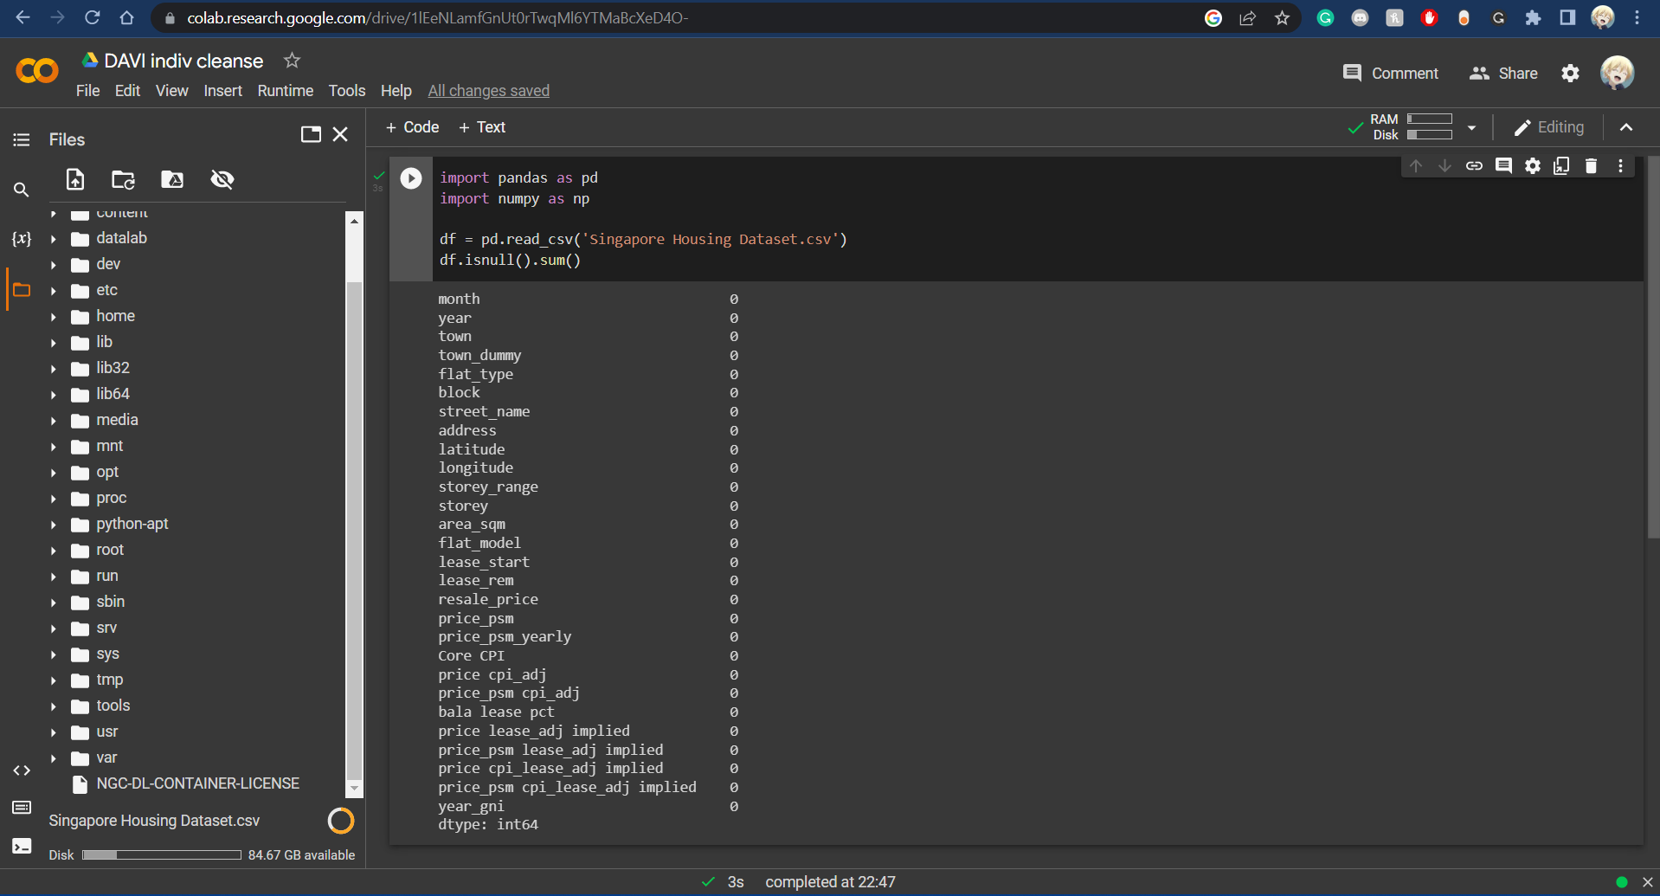
Data Summary
Using Google colab and pandas, I scanned for any null datas in order to cleanse and wrangle the data.

Slide 4
Storyline:
Mr Tan is looking for a house in Singapore that could accommodate for his whole family and these are his requirements:
-A budget of $300k.
-Currently, he lives with his wife, 2 children and father.
This means that he requires a relatively larger house
-Additionally, if possible, they would like to live nearer to the North so that his wife is able to visit her parents, who are in Serangoon.

Slide 5
Objectives
01
02
03
Price
Distance from parents
Finding out what affects the pricing of houses in Singapore
Distance from Mr Lim’s parents-in-law so that they are able to visit in case of emergencies
Location
Finding out the best area for Mr Lim to purchase a house in order to accommodate for his family’s needs.

Slide 6


Price
01
-From the first sheet, we can see that one of the factors that affect the cost of housing is the flat type.
- The first dashboard displays the range of values of individual units in Singapore.
-Shows Mr Lim which towns have the most affordable housing in Singapore and how many rooms the unit has, as well as the CPI of the HDB.

Slide 7
02
Location
-From the second dashboard, we get to see all the different range of prices in different towns
-We can see that Punggol, Bukit Timah and Sengkang can be taken into less consideration as the average resale prices are a lot higher than the budget.
-However if we were to see the lower end, it has too many 1 and 2 room flats, which will not be able to accommodate for Mr Tan’s family.

Slide 8
02
Distance
-From the third sheet, we can see the houses in the distance from Mr Lim’s in laws.
-We can see that generally, the prices of the houses within 5km is higher than those not within 5km.
-However there are still a lot of houses that are within 5km and affordable for Mr Lim that have enough room for his entire family.

Slide 9
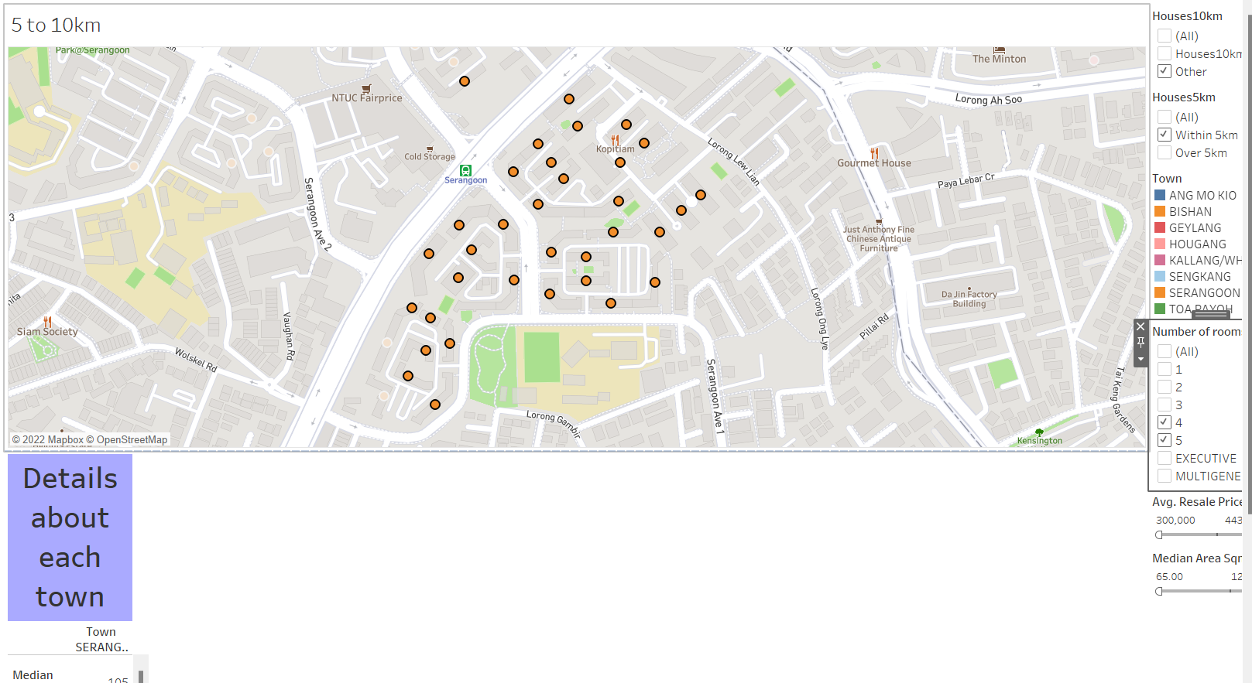
Recommendations:
This is my recommendation. This is because not only does the area have a lot of 4-5 room flats that are available, it also has a lot of commodities around the area. This will allow Mr Lim to travel around very easily as well as reach his in laws very easily. Furthermore, this will decrease the travel time of his 2 children to school.

Slide 10
Links used:
For CPI: https://logikalprojects.com/insights/understanding-the-cost-performance-index-cpi-on-your-project/
For Price PSM:
https://fizbot.net/en/blog/what-is-the-square-meter-unit-price
Please keep this slide for attribution

